Slide 1

Developing Augmented Reality Experiences with ARKit 6

Slide 2


Solution Architect
9 years at Neudesic
14+ years experience in the mobile space
Loves to code and innovate

Slide 3
Table of contents
Why Augmented Reality ?
RealityKit & SceneKit
Coordinate System
Matrix Transforms
Demo 1: Getting Started
AnchorEntity
Demo 2: Some new features
4K video
Ray casting
Demo 3: Occlusion & Transforms
App Clips

Slide 4
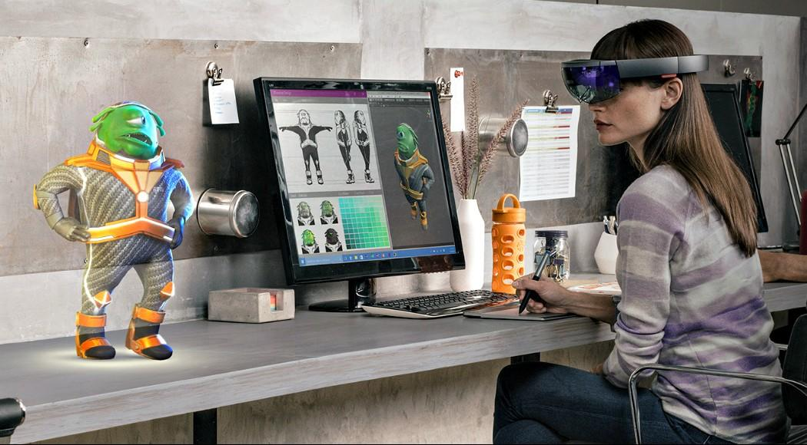
Why Augmented Reality ?
Growth in market
Market Research Future (MRFR) asserts that the global augmented reality market is estimated to reach USD 461.25 BN by 2030
Evolving 3D space
AR Glasses
This Photo by Unknown Author is licensed under CC BY-SA-NC

Slide 5
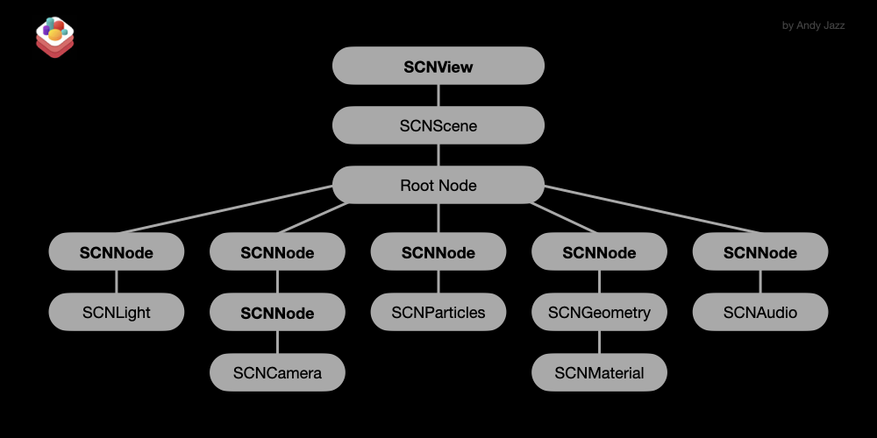
ARKit & SceneKit

Slide 6
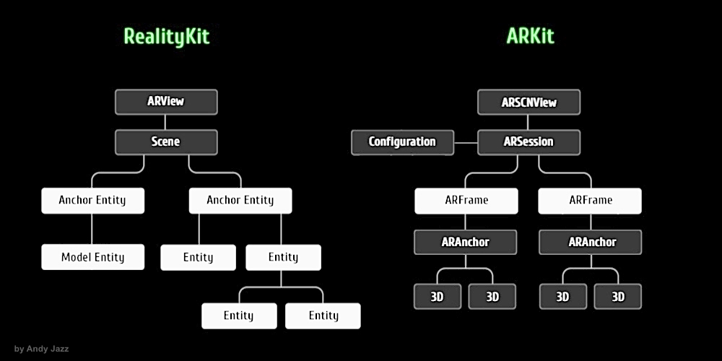
ARKit & RealityKit

Slide 7
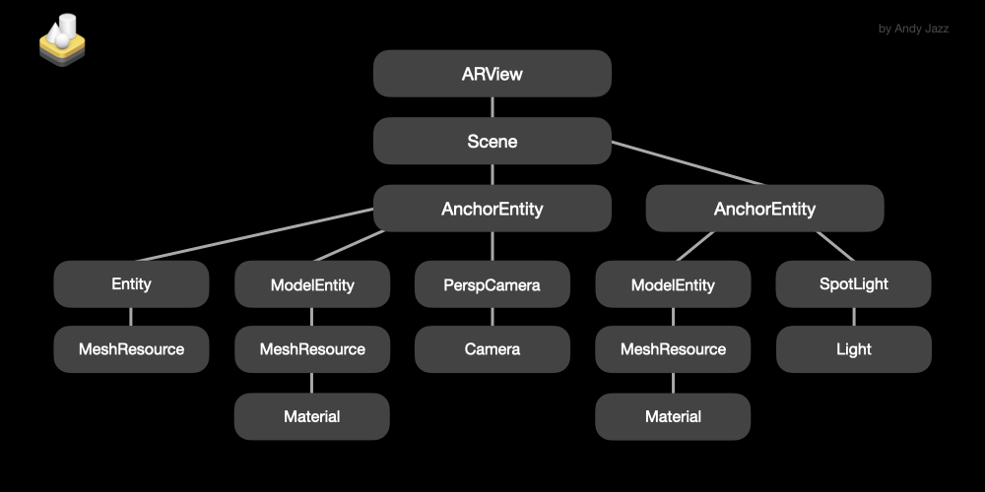

Slide 8
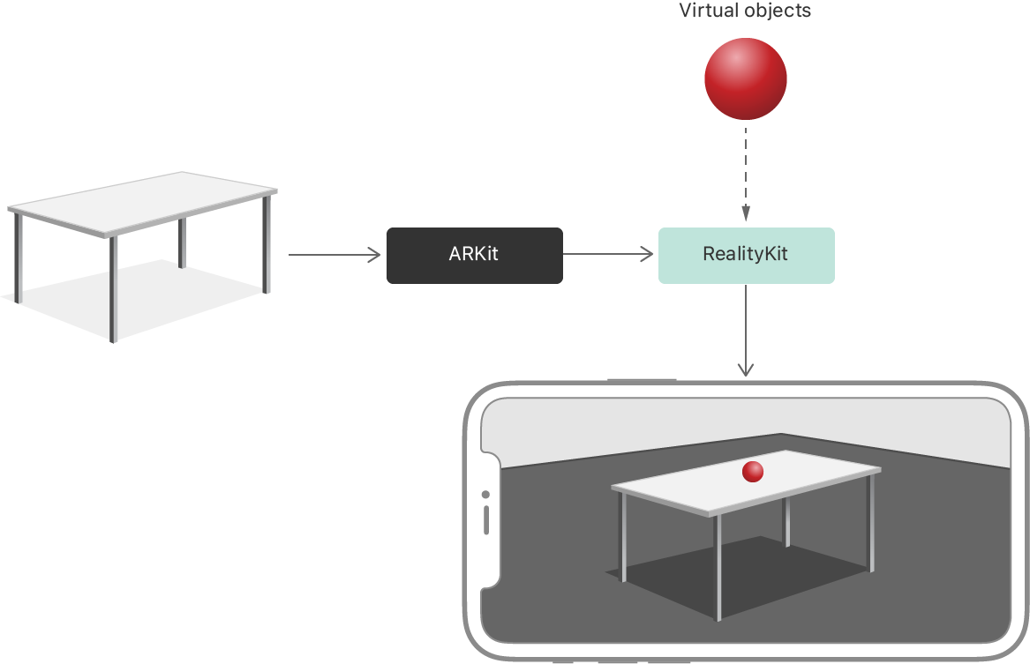

Slide 9
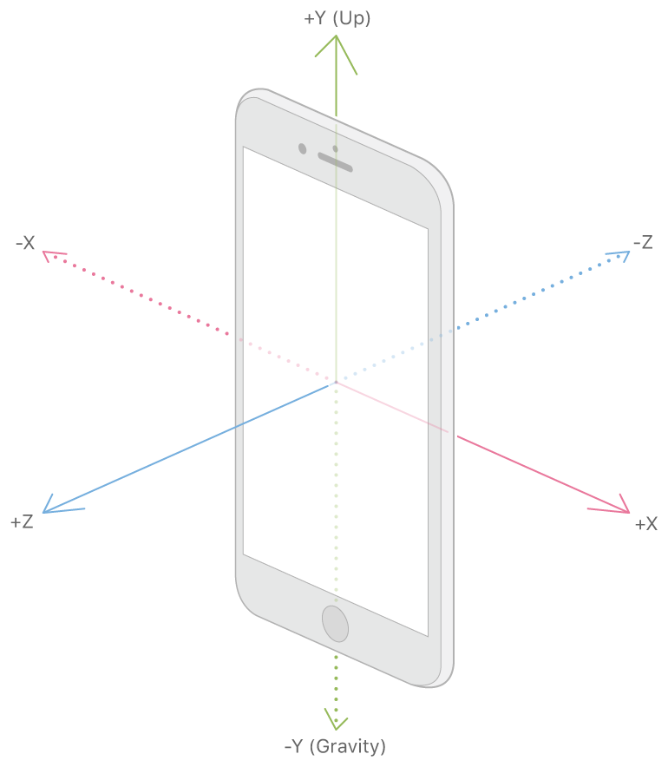
ARKit Coordinate System

Slide 10
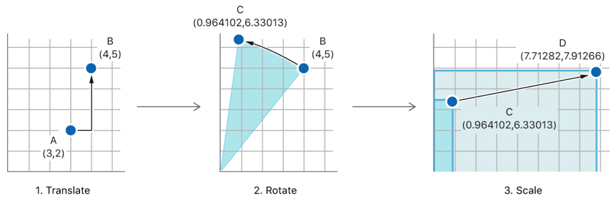
Transforms – Translate, Rotate, Scale

Slide 11
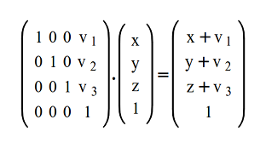
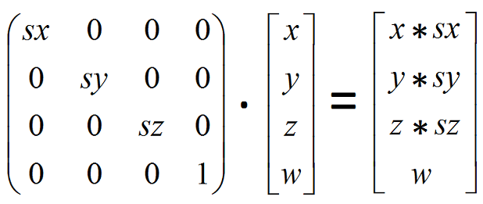


Translate
Scale
Rotation

Slide 12
Demo 1 : Getting Started
Create your first RealityKit experience!
Using Reality Composer
Working with AnchorEntity and ModelEntity
Using the ARWorldTrackingConfig

Slide 13
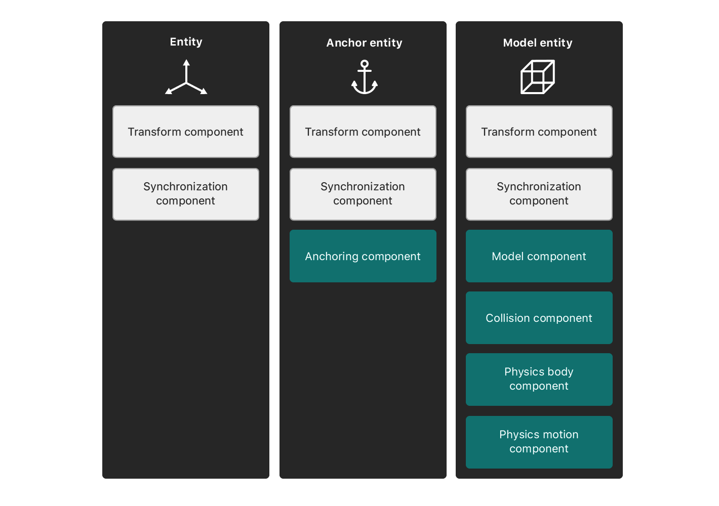

Slide 14
AnchorEntity
ARAnchor
helps implement 10 ARKit anchors, including ARGeoAnchor and ARAppClipCodeAnchor
body
camera
face
image
object
plane
world
raycastResult

Slide 15
Demo 2: Some new features
Handling user input
Hit-test / Ray casting
4k video (iOS 16, ARKit 6)
High resolution capture (iOS 16, ARKit 6)
HDR (iOS 16, ARKit 6)
Session Delegate
Debugging

Slide 16
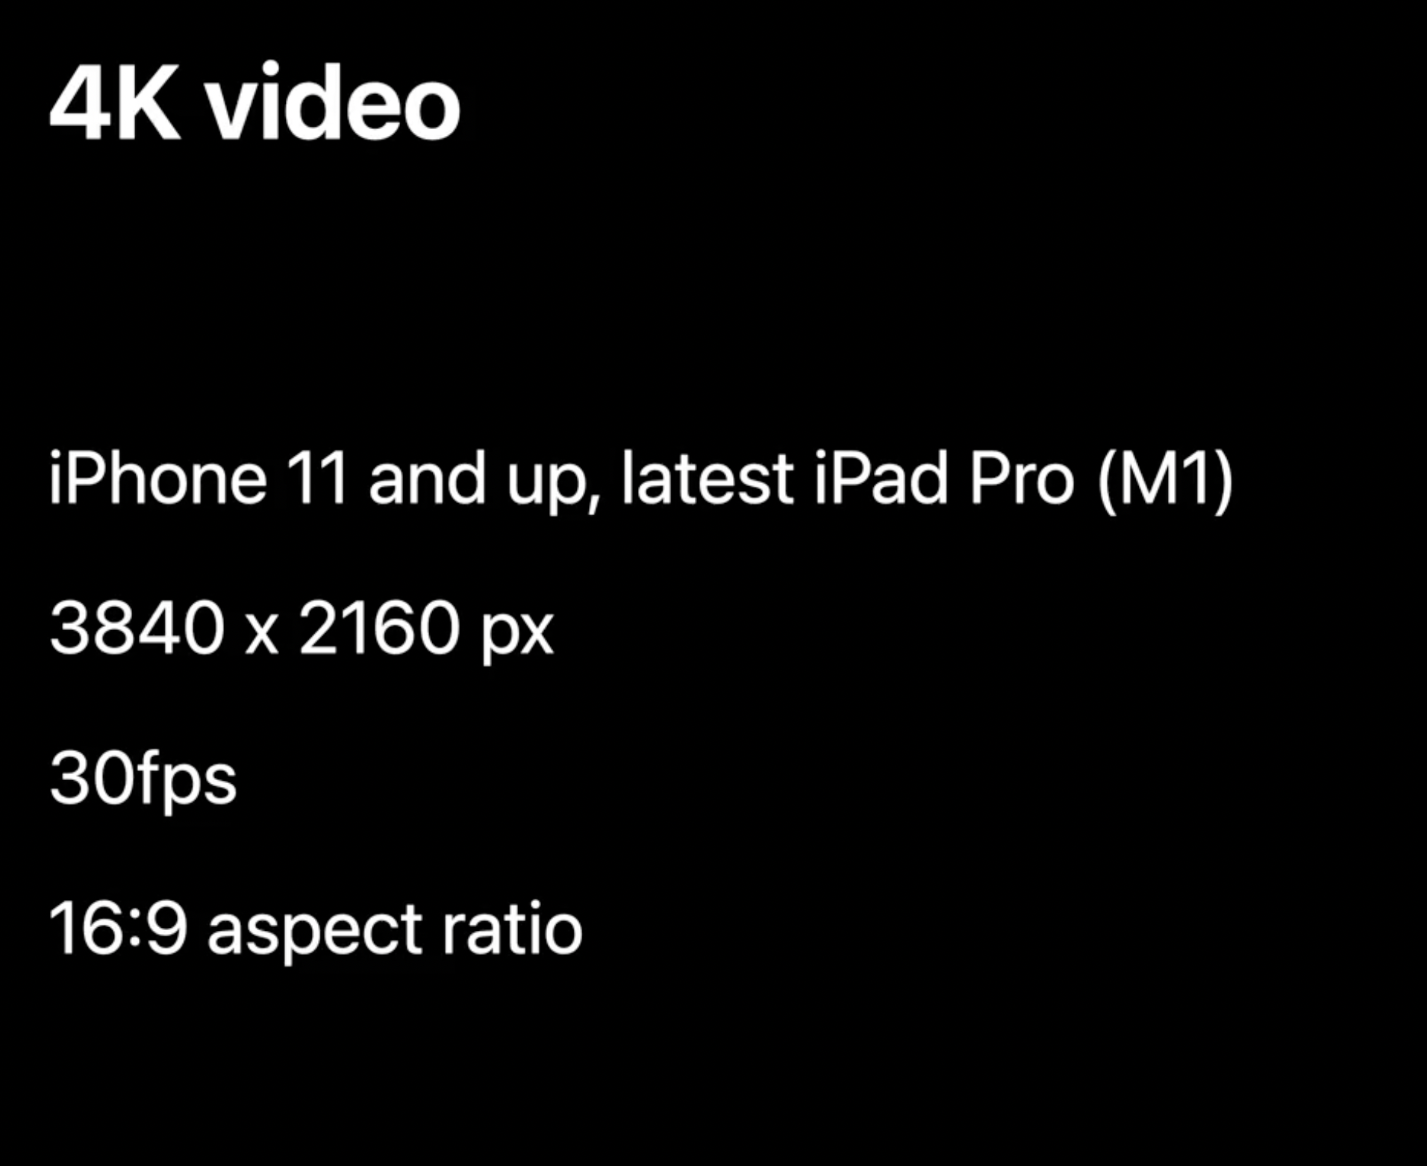

Slide 17
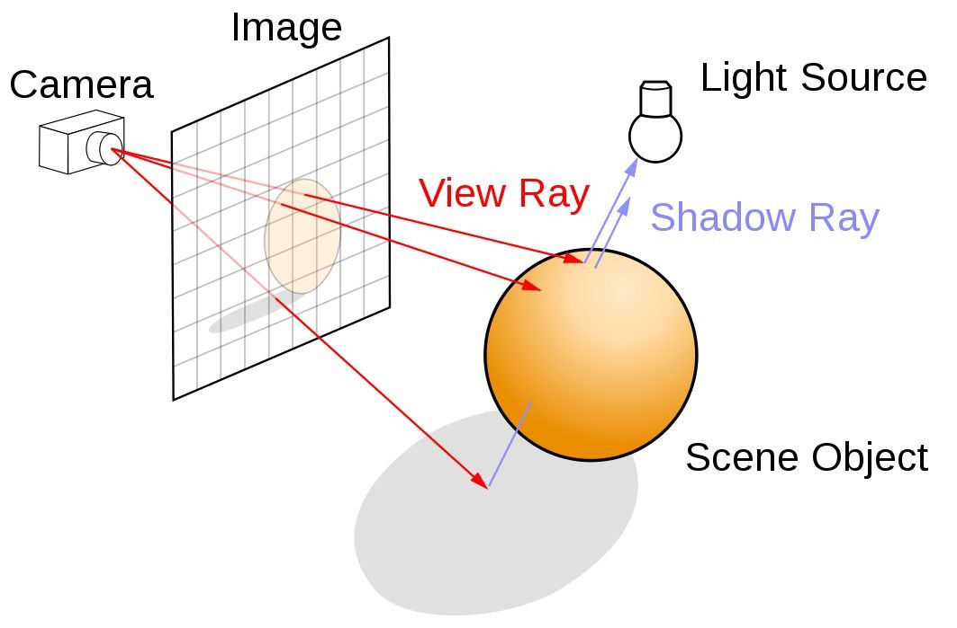
Ray casting

Slide 18
Demo 3: Occlusion & Transforms
People Occlusion
Translate, Rotate and Scale with transformation matrices
Behaviors in Reality Composer
Coaching Overlay
Notes:
// Coaching Overlay
// People occlusion
// Environment occlusion
// Reality composer behaviors
// Matrix Transformations

Slide 19
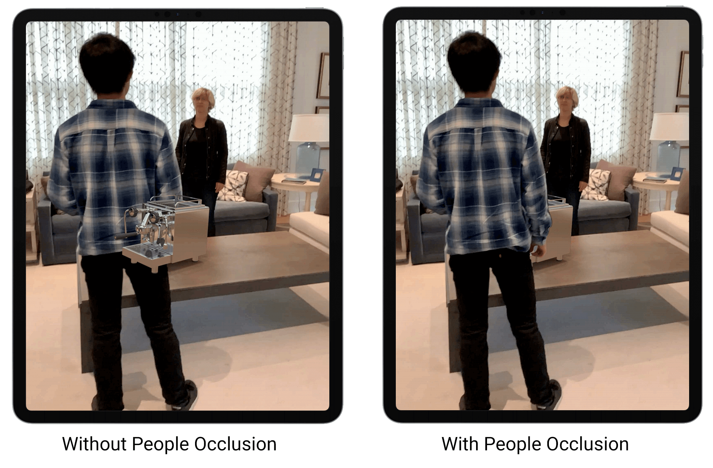
Occlusion

Slide 20
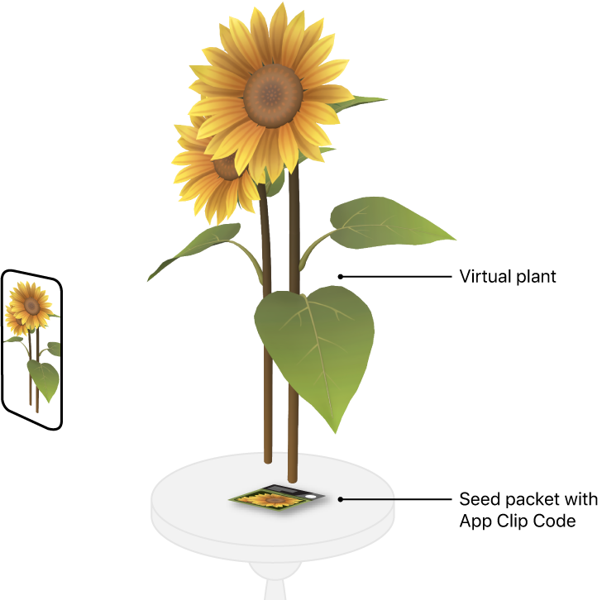
App Clip Code tracking
Support was added with ARKit 4
Only supported by Apple Neural Engine devices
Similar to a QR Code
App Clip has an URL that just needs to be decoded

Slide 21
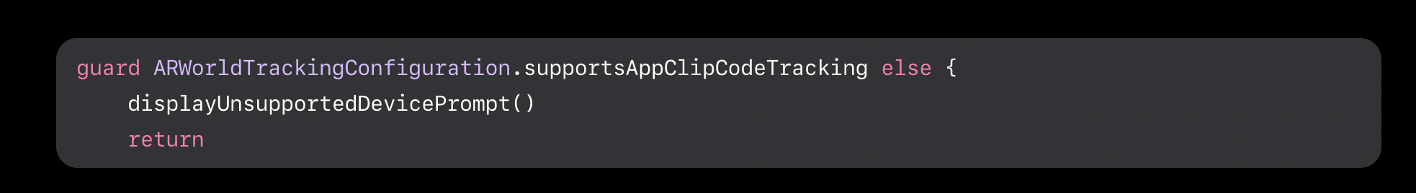

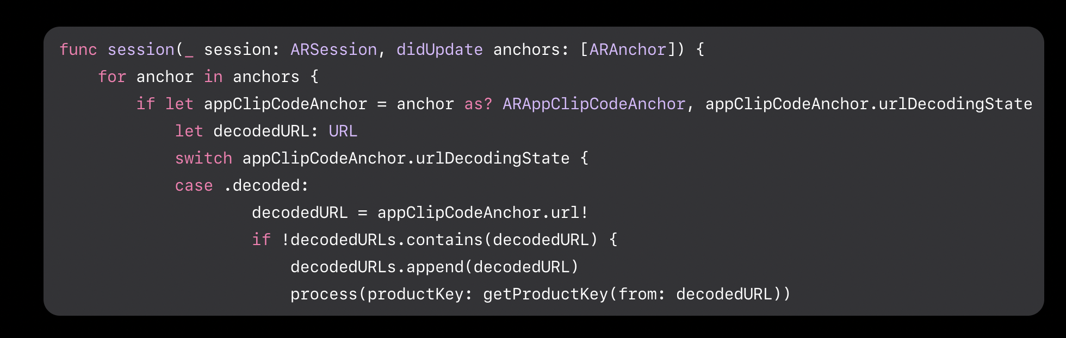
App Clip Code: sample

Slide 22
Q & A

Slide 23
Demo 4: Vision & ARKit

